Slide 1
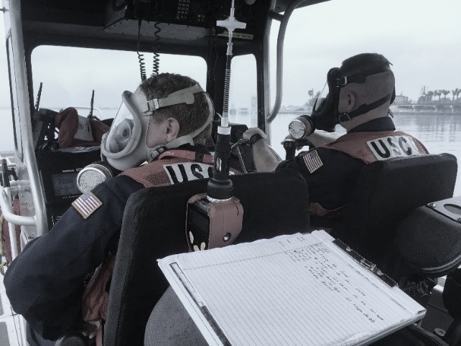

U.S. Coast Guard
National Strike Force
World’s Best Crisis Leaders and Technical Responders:
Any Time, Any Place, Any Hazard

Slide 2
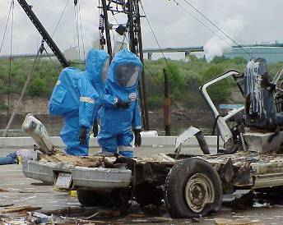
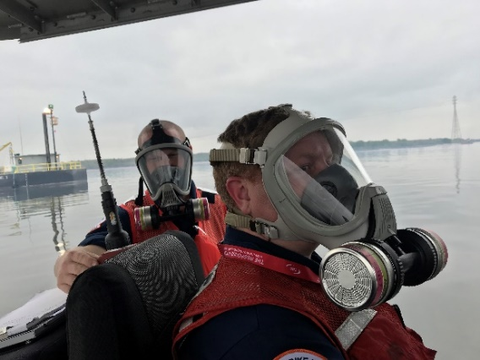

National Strike Force Mission
“Special Team” to assist USCG/EPA Federal On Scene Coordinators and other federal officials under the NCP & NRF.
Deploy highly trained personnel & specialized equipment for response to oil/hazmat pollution cases, WMD incidents, and disasters.
What We Do:
  Oil Spill Response
  Hazardous Substance Response
  Chemical, Biological, Radiological, Nuclear (CBRN) Response
  Oil & Chemical Pumping
  Natural Disaster Response
  Small Boat Operations
  Incident Command System (ICS) & Response Management Support
  Preparedness Exercises
  National Special Security Events
2

Slide 3
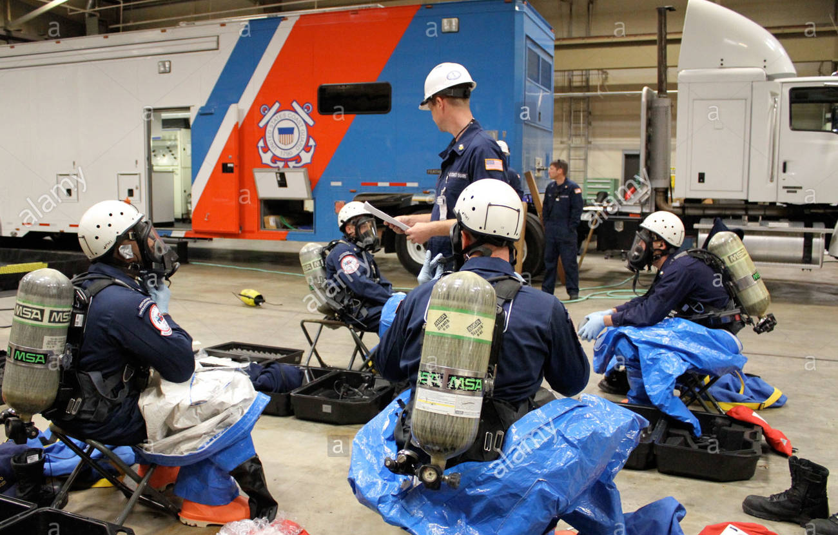
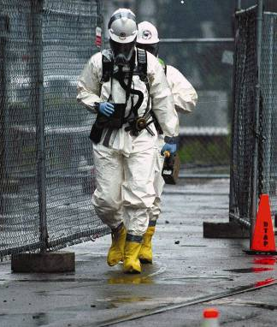
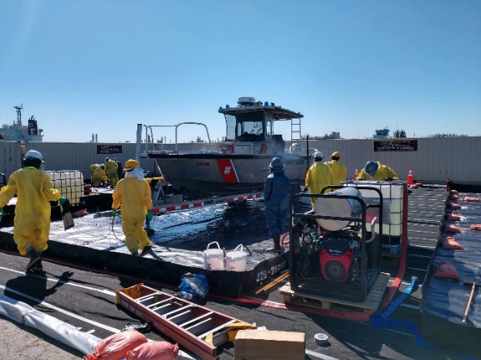
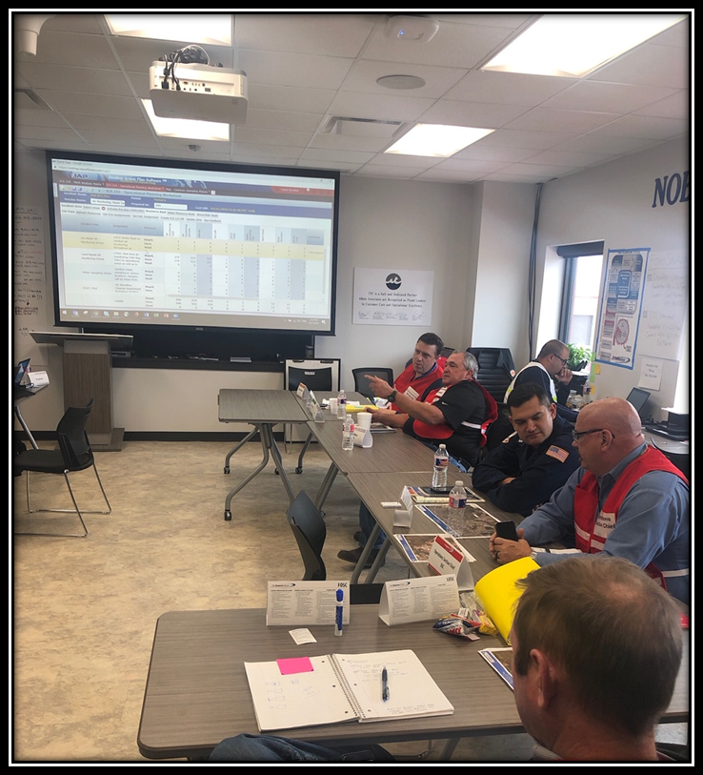
National Strike Force Functions
    Incident Command / Response Management Support
    Oil and Hazardous Materials Response
    WMD Response including Radiological and Bioterrorism incidents
    Decontamination
    Boat Operations
    Contractor / Responsible Party Oversight
    Preparedness Exercise and Event Planning Support
3

Slide 4
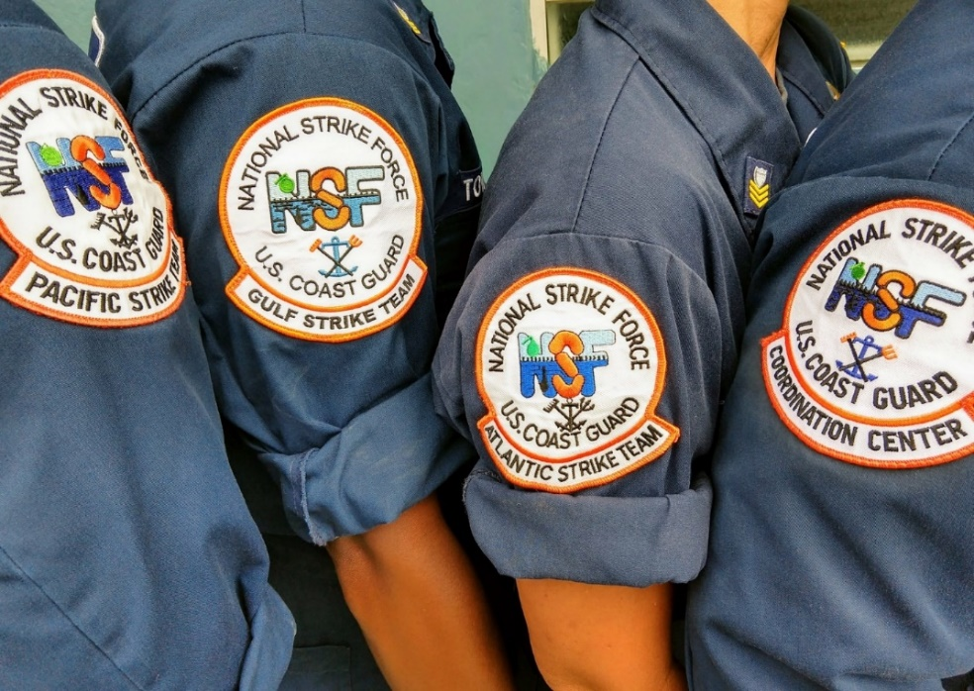
Elements of National Strike Force
NSFCC
PIAT
National Strike Force Coordination Center
  Public Information Assistance Team
  Incident Management Assist Team
  3 Strike Teams (Atlantic, Gulf, Pacific)
Standardized Response Equipment
Highly Trained and Experienced Personnel
24 x 7 x 365 Recall Status
AST
GST
PST
IMAT
4

Slide 5
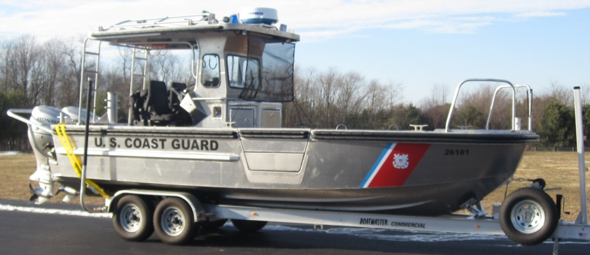
Strike Team Composition
Command
Operations
Logistics
Training
IH
Chemical
Engineering
Deck
Supply
Admin
Medical
Gulf Strike Team
  ~ 38 Active Duty
  ~ 32 Reserve Members
  ~ 2 Civilian
Diverse/Skilled Workforce:
  Nine ratings/specialties
  Every member is first and foremost a responder regardless of rate/rank
  Vast maritime experience
  Operational Collaterals: CDL, Boat Coxswain & Crewman, EMTs, UAS Pilots, Confined Space Rescue teams, Incident Command Systems SMEs
7
5
5

Slide 6


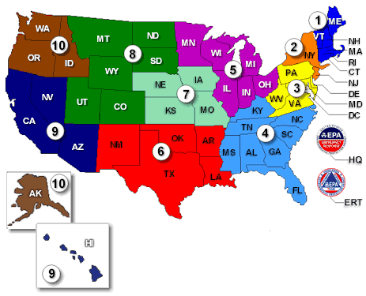

Strike Team AORs
PST
Novato, CA
AST
Fort Dix, NJ
CG-IMAT
Norfolk, VA
NSFCC
Elizabeth City, NC
GST
Mobile, AL
6

Slide 7
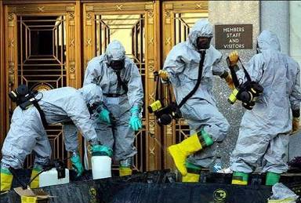
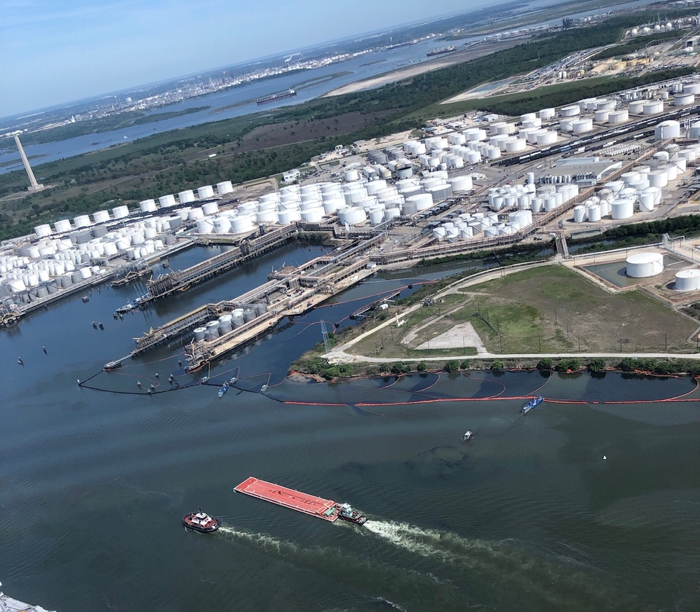
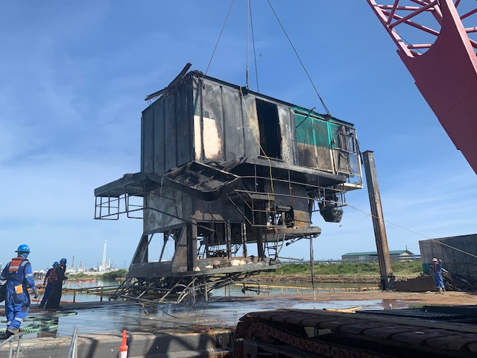
Gulf Strike Team Case Load
Average Annual Case Load:
- 10-15 Cases (large scale cases)
- 50% Oil Responses
- 25% Chemical Responses
- 25% Disaster Responses
- Personnel 160+ days deployed
7
Notes:
Pictures (left to right)
1: The superstructure of Dredge Waymon L. Boyd is lifted from the Corpus Christi shipping channel.
2:
3:

Slide 8
Qualifications & Composition
NSF Qualifications
  Response Officer (RO)
  Response Supervisor (RS)
  Response Technician (RT)
  Response Member (RM)
Similar Qualification
  IC/OSC/FOSCR
  Branch Dir/DIVS/FOSCR
  HAZMAT Technician
  Pollution Responder
Duty Team Composition
  12-person B-24 Team
    1 Response Officer
    2 Response Supervisors
    2 Response Technicians
    7 Response Members
Quick Response Team
  Two B-6 Teams
    Response Supervisor
    Response Technician
    Response Member
8

Slide 9
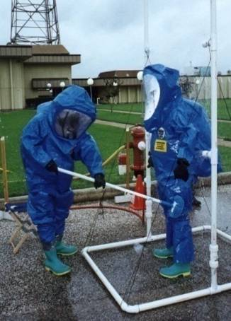
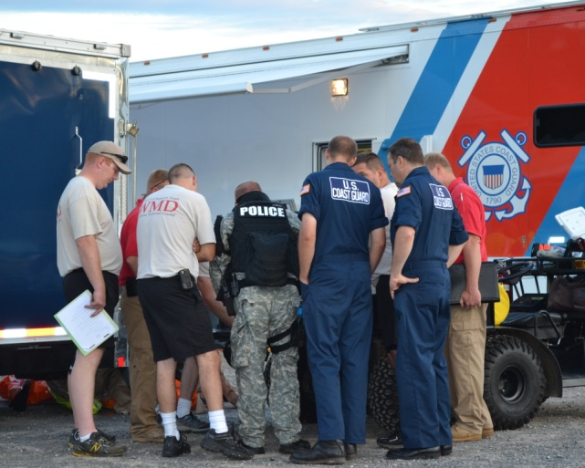
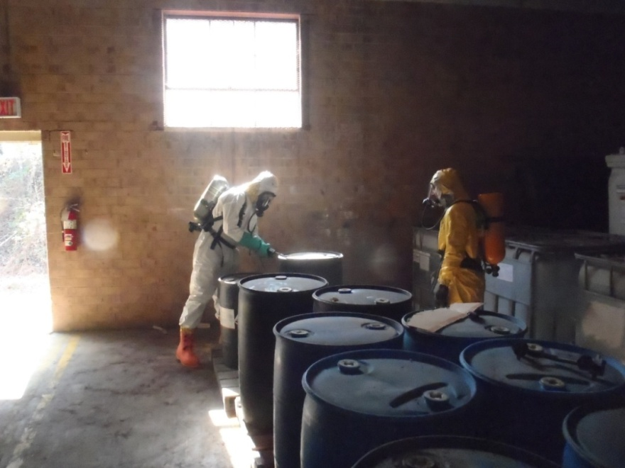
Response Policy & Reach Back
Facilitate Interoperability
  Standardized training & equipment
  60 – 20 – 20 load sharing
Response Resource Reach Back
  DOE’s Radiological Assessment Program Teams
  Civil Support Teams (Alabama: 46th CST)
  FBI Hazardous Materials Response Unit
  DOD Explosive Ordinance Detachments
  EPA Radiological Emergency Response Team
  NOAA’s Scientific Support Coordinator
9

Slide 10
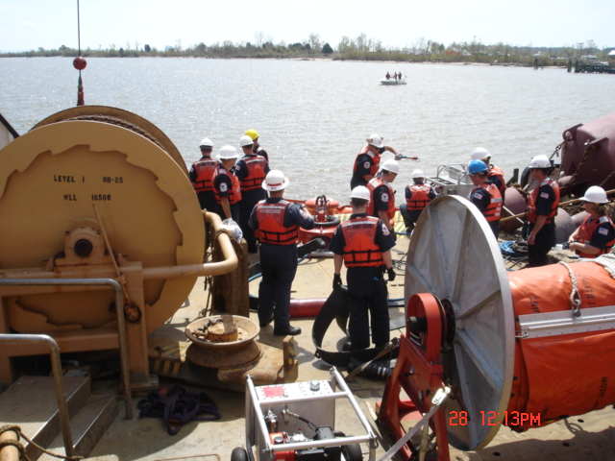
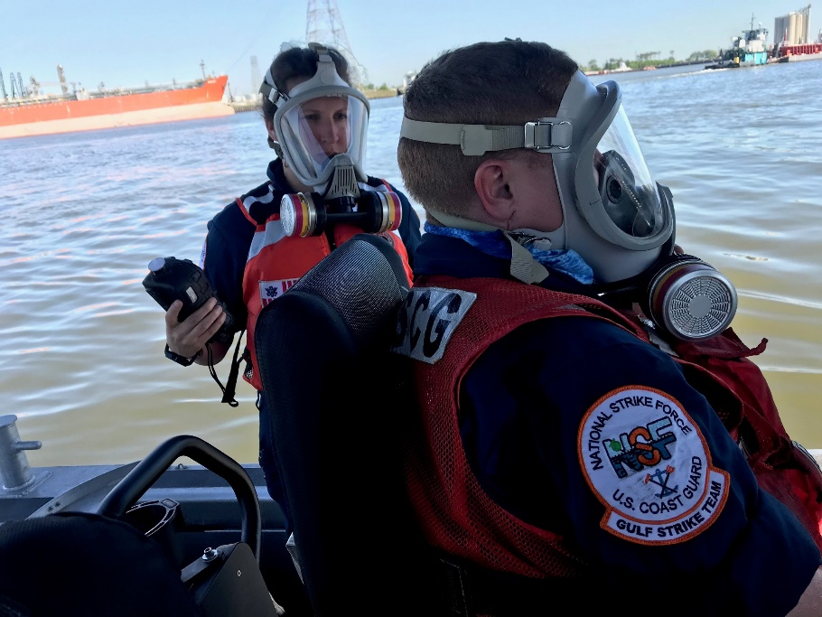
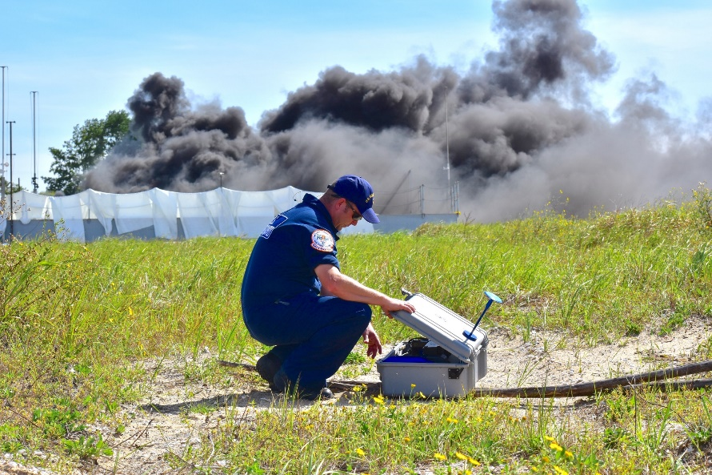
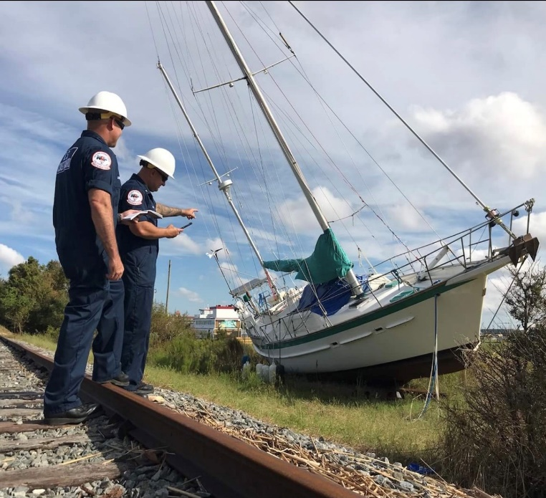
Oil Spill Response
Equipment
  Oil Pumping Systems
  Damage Assessment Tools
  Special Monitoring of Applied Response Technology (SMART)
    Fluorometers (Dispersants)
    DustTrak (In -Situ Burning)
Expertise
  Source Control and Removal of Oil
  Qualified Federal OSC Representatives
  Shoreline Assessment
  Site Safety
  Salvage Monitoring and Lightering
  Contractor / Responsible Party Oversight
  Legacy VOSS/SORS experience
10

Slide 11
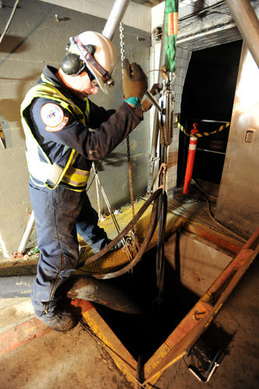
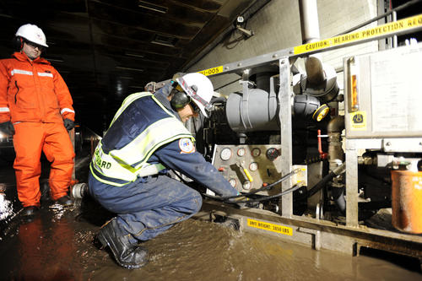
Pollution Pumping Capability
Pumps
  CCN 150 (centrifugal)
  Wildens M1, M8, M15 (pneumatic diaphragm)
  Desmi (DOP 250)
Oil/Chemical/HAZMAT pumping
  CCN 150 with chemical fittings/hoses
  Teflon diaphragm pumps
  Peristaltic
11

Slide 12
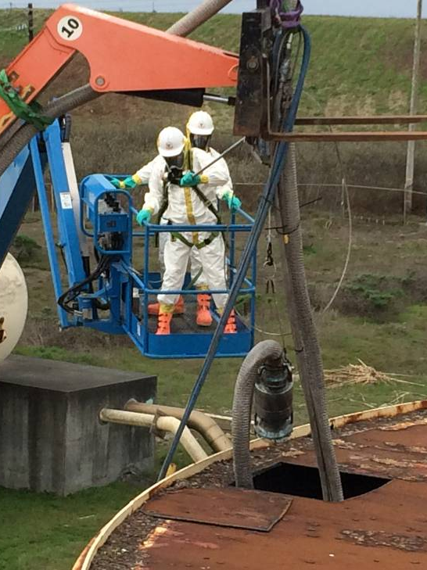
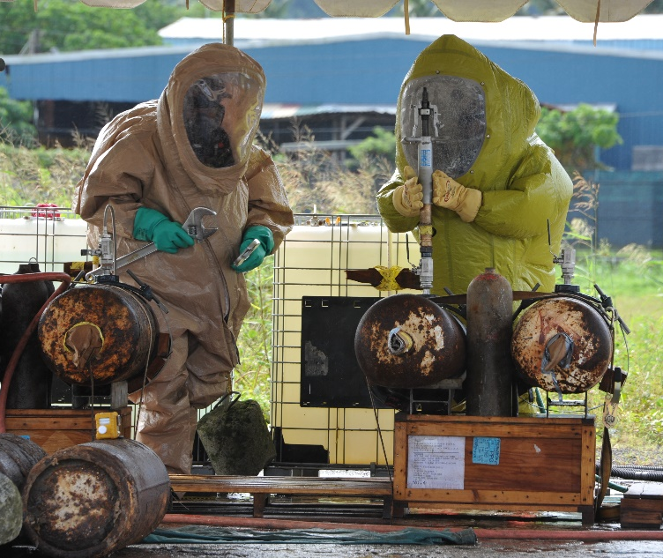
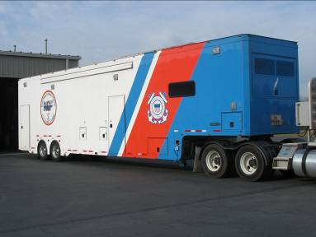
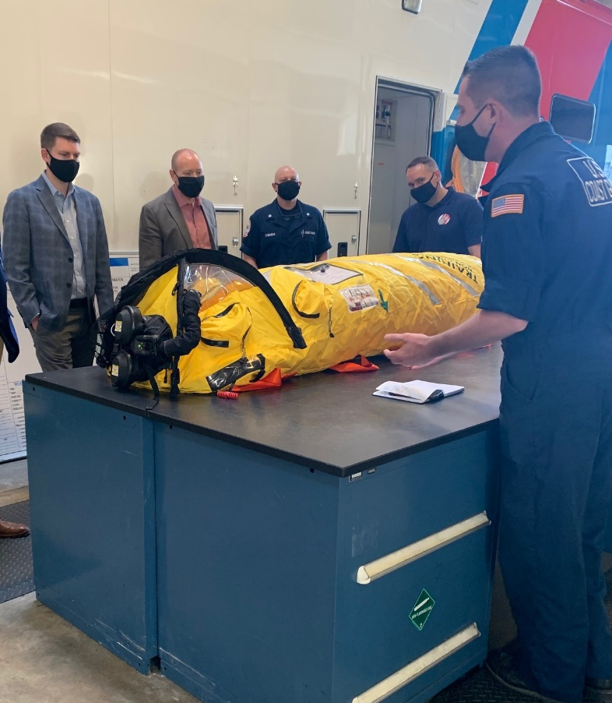
Hazardous Substance & CBRN Response
48 foot HMRT
Provides long-term response support
5,000 psi compressor
Elevated observation area
40-KW Generator or electrical shore tie
Self-sufficient for 72 hours
Level “A/B/C” Entry, and Decon
Site assessment, characterization, and mitigation
Real time monitor/ID of chemical agent
Multi-media sampling (air, water, soil) for field testing, and laboratory analysis
12

Slide 13
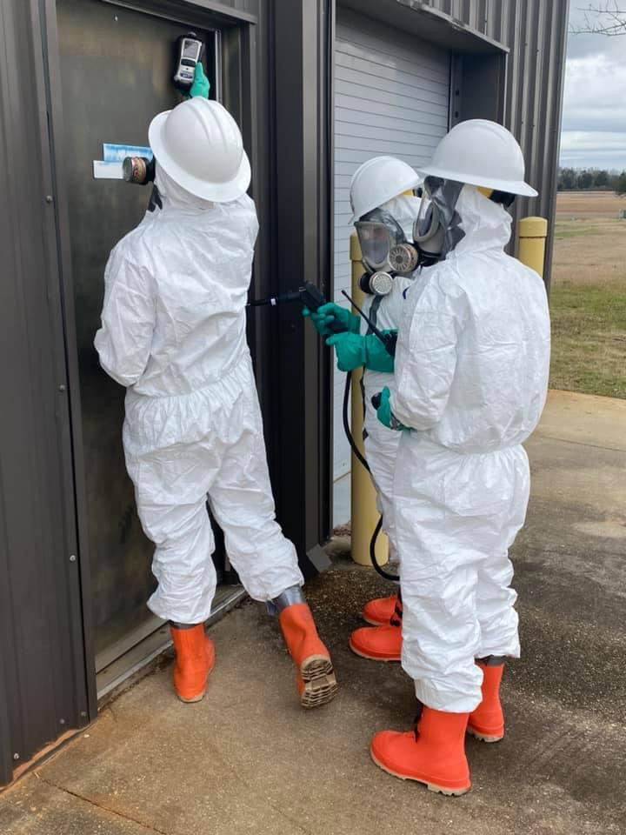
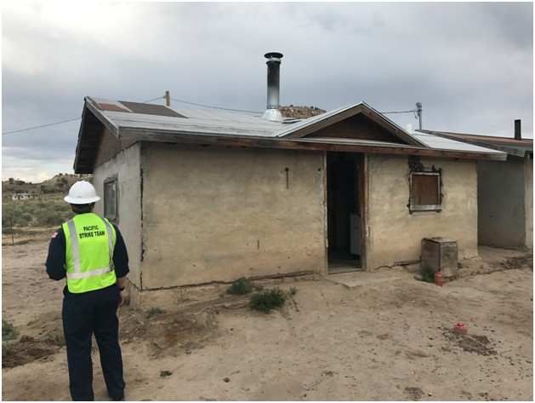
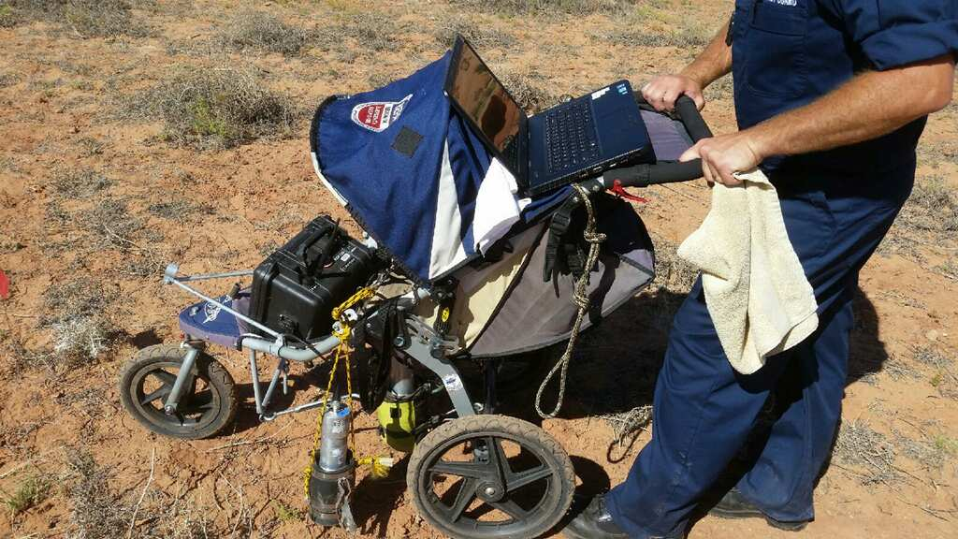
Radiological Response
Radiation detection
Site assessment, characterization & technical assistance with site mitigation
Real-time dosimetry
Radiological Isotope Identification Device
Secondary device awareness & recognition
Radiation Safety Officer (IH)
13

Slide 14
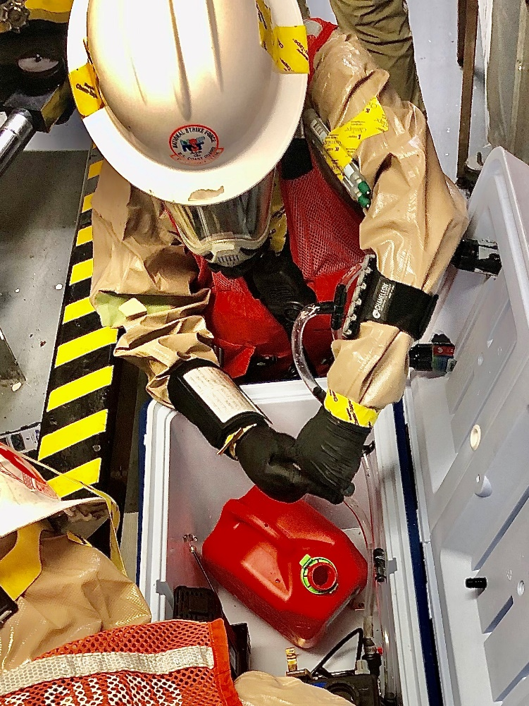
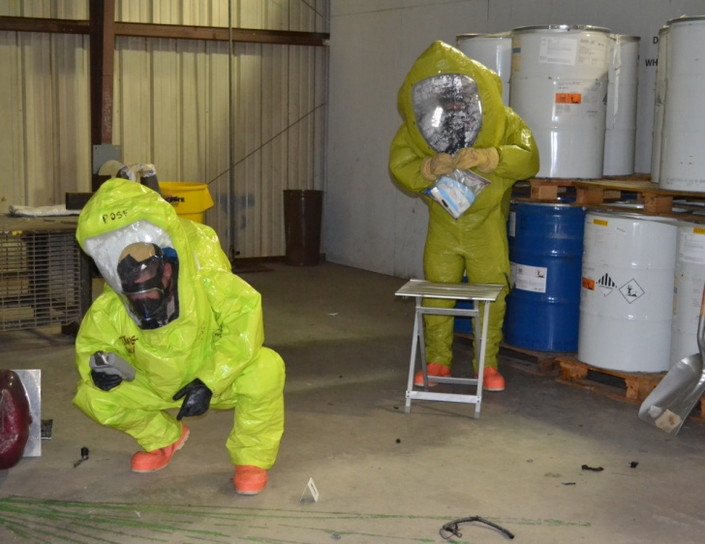
Weapons of Mass Destruction
Natural extension of hazmat response
Level “A” entry
Personnel Decontamination
Field presumptive detection for chemical warfare agents
Sampling and Chain-of-Custody
Secondary device awareness and recognition
Real world experience
  World Trade Center
  Anthrax and Ricin Decontamination, Washington, D.C.
  Pre-staging for National Special Security Events (NSSEs)
14

Slide 15
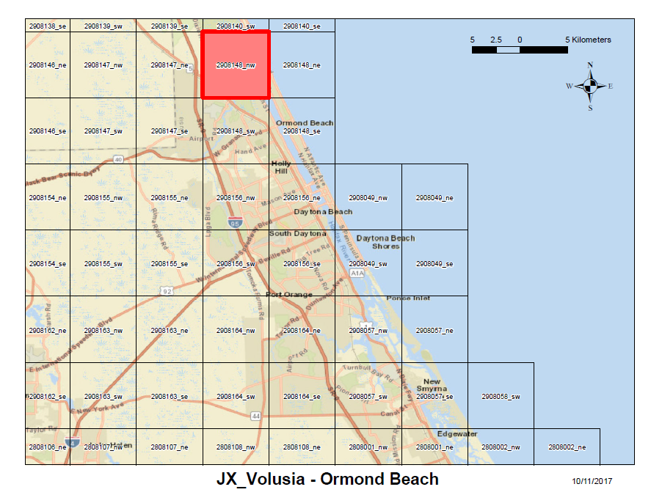
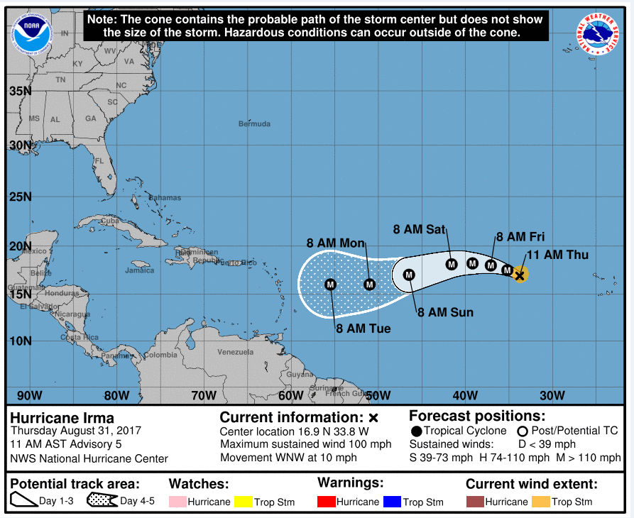
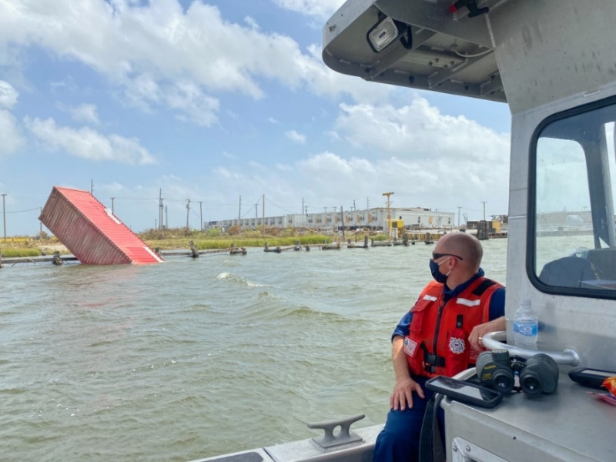
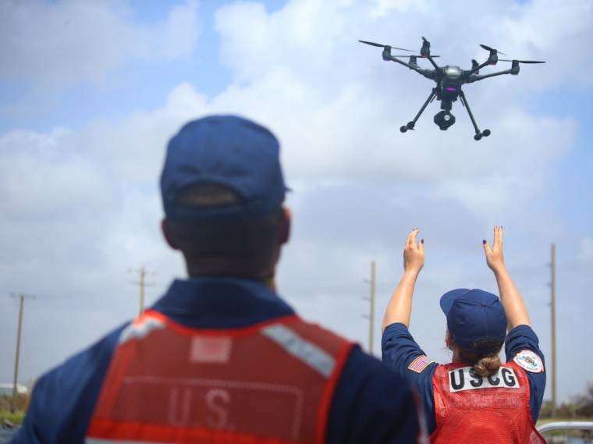
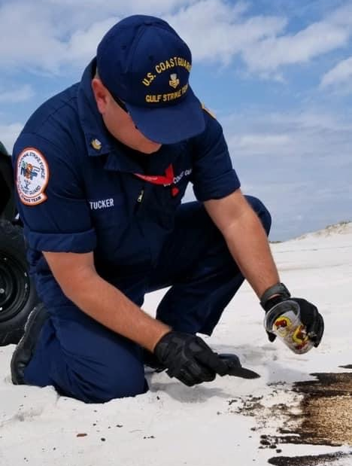
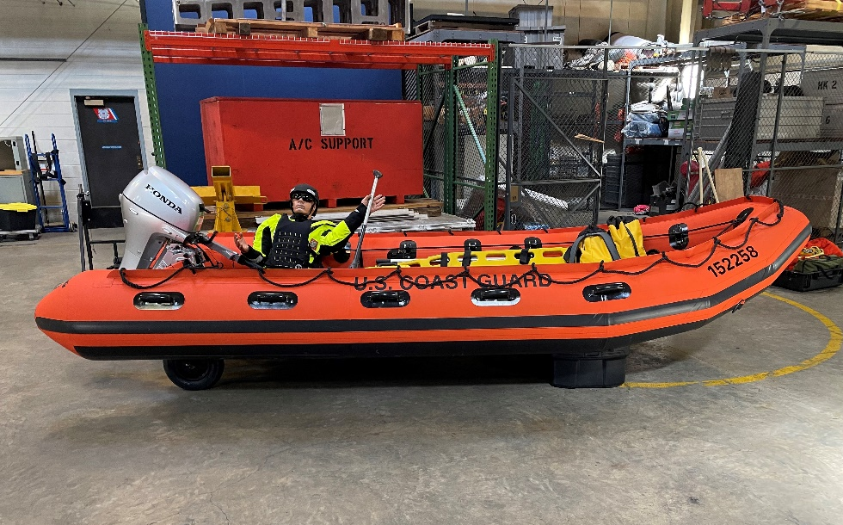
Disaster Response
Type 1 & 2 Responses
Pre-Stage for Hurricanes
  Port Reconstitution
  Pollution Assessments
    Land, Sea, Air
ESF-10: Oil & Hazmat Pollution
  Mission Assignments
  Incident Specific FOSC
15
Notes:
Pictures (Left to Right)
1:
2: EM1 McLeod launches a UAS drone for aerial surveillance during post-Hurricane Laura port assessments.
3: BMC Tucker takes an oil sample on Orange Beach during post-Hurricane Sally operations.
4:

Slide 16
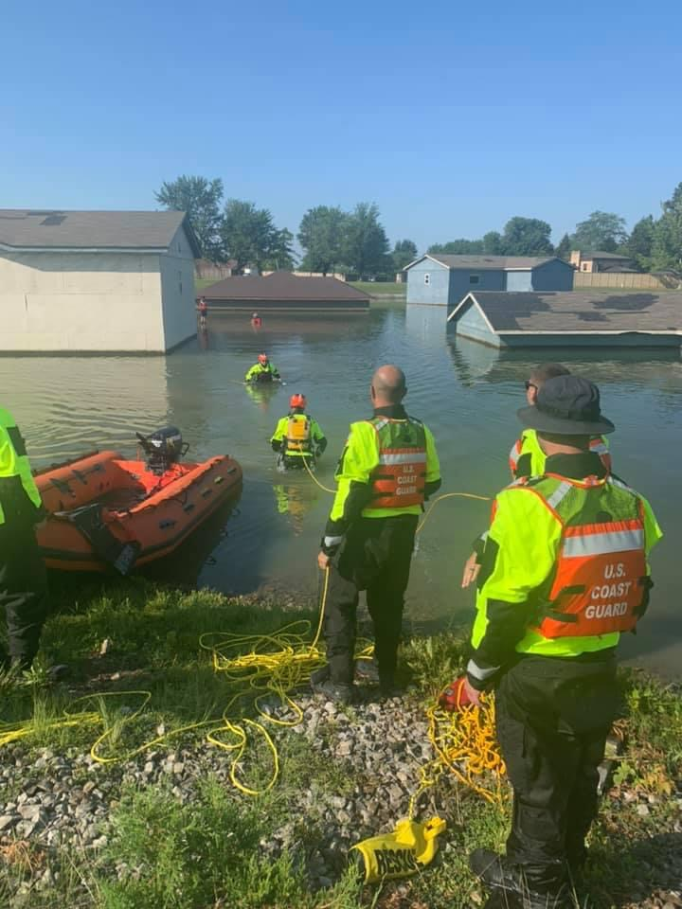
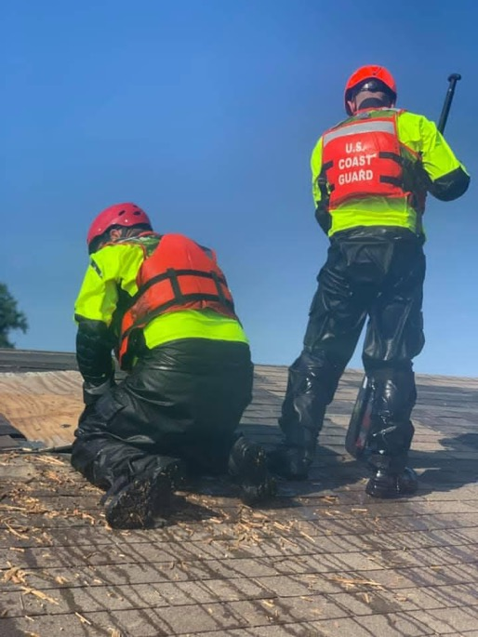
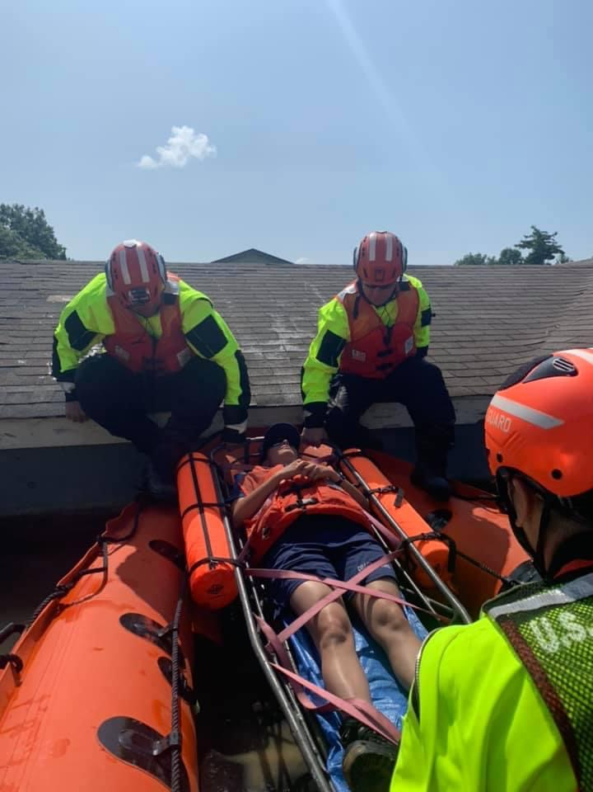
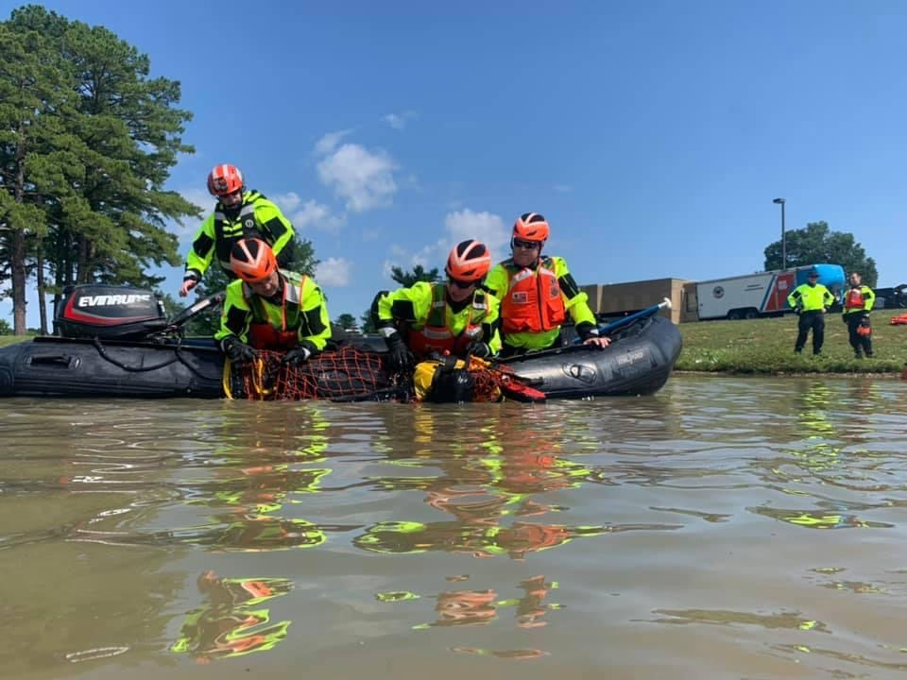
Catastrophic Incident
Search & Rescue (CISAR)
Comparable to FEMA Urban Search and Rescue teams operating under ESF-9
Can Provide fully trained & equipped CISAR teams:
  Flood Response Team Leaders (02), Coxswains (06), and Responders (04)
  4 inflatable Combat Rubber Raiding Crafts (CRRC)
  2 staged Mobile Response Kits (MRK)
  2 18’ SKF boats
  Associated rigging and entry gear for flood response (saws, axes, rescue gear)
16

Slide 17
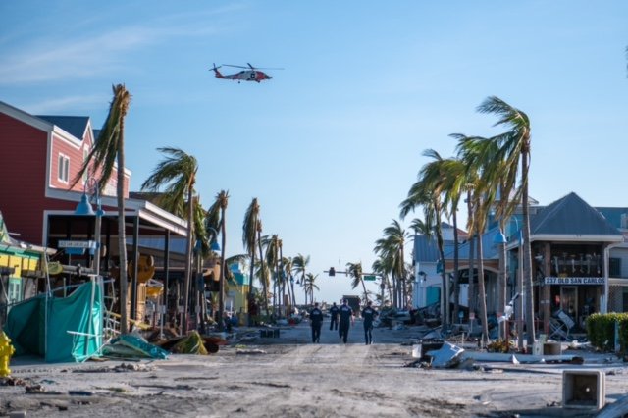
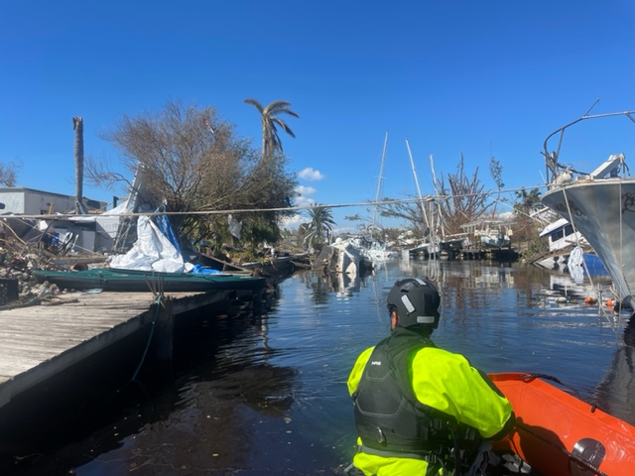
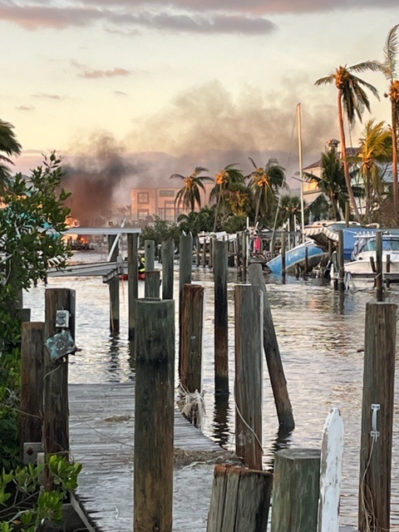
Case Review
Hurricane Ian
On 28SEP2022, Cat-4 Hurricane Ian made landfall in SW Florida.
ESF-9: CISAR teams saved/assisted 746 lives, transported 74 First Responders, and provided life sustaining supplies to areas devastated by the storm.
ESF-10: Hurricane Ian IMT assessed 7,529 targets, conducted removal ops on 520 vessels, recovered 36,027gal of petroleum and 6,635lbs of HAZMAT.
17

Slide 18

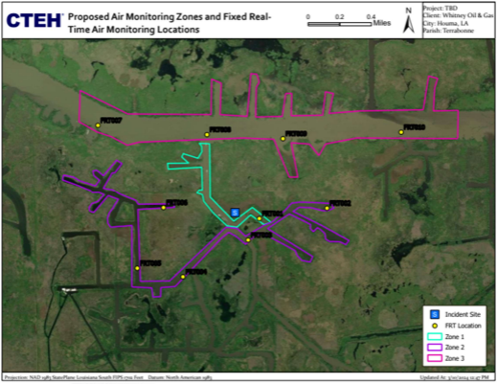
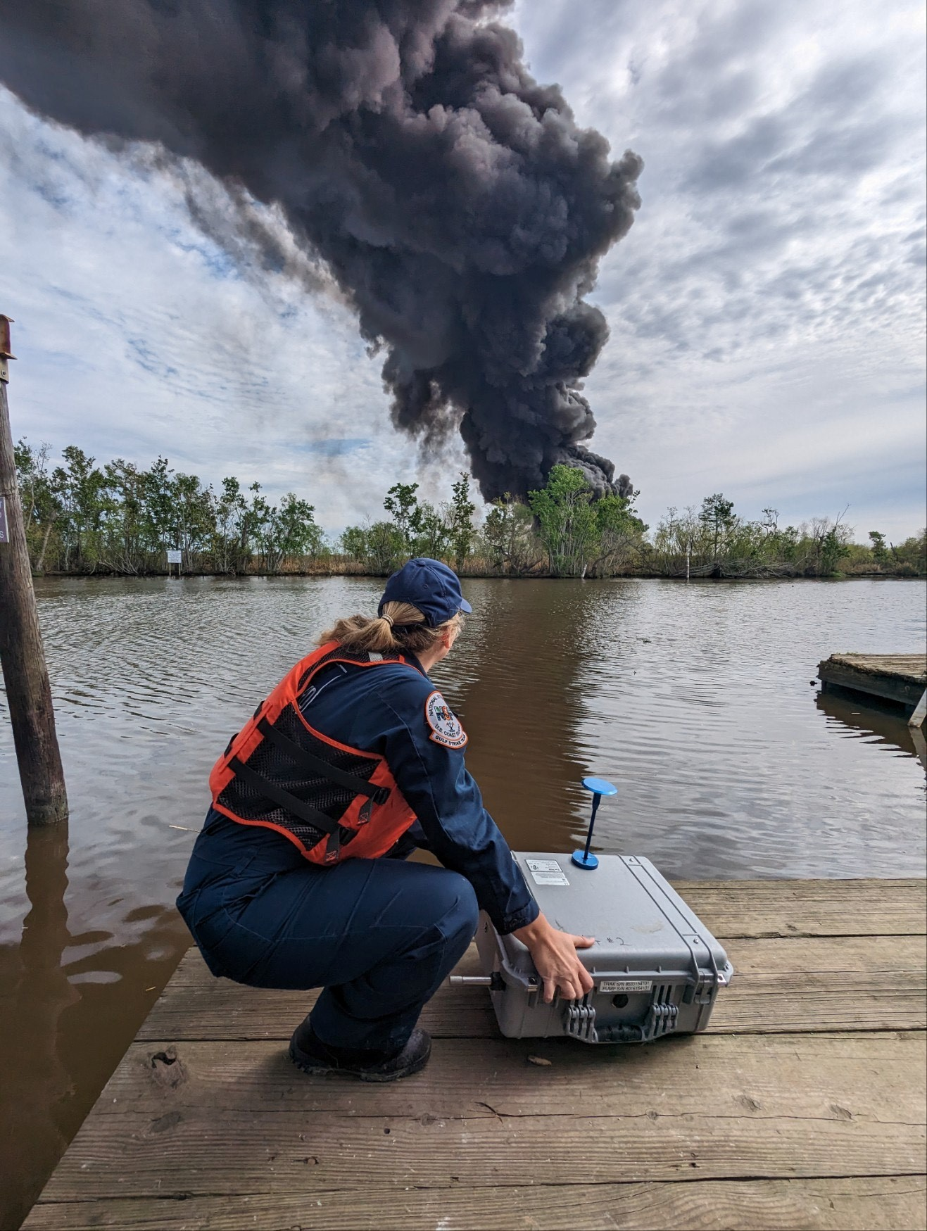
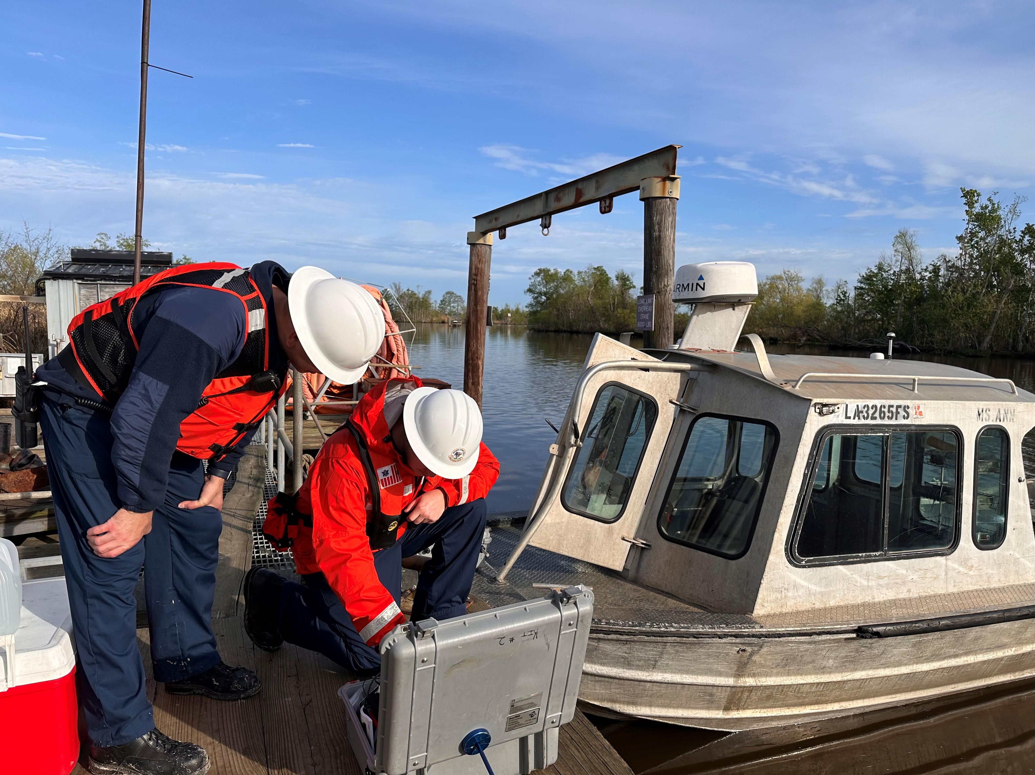
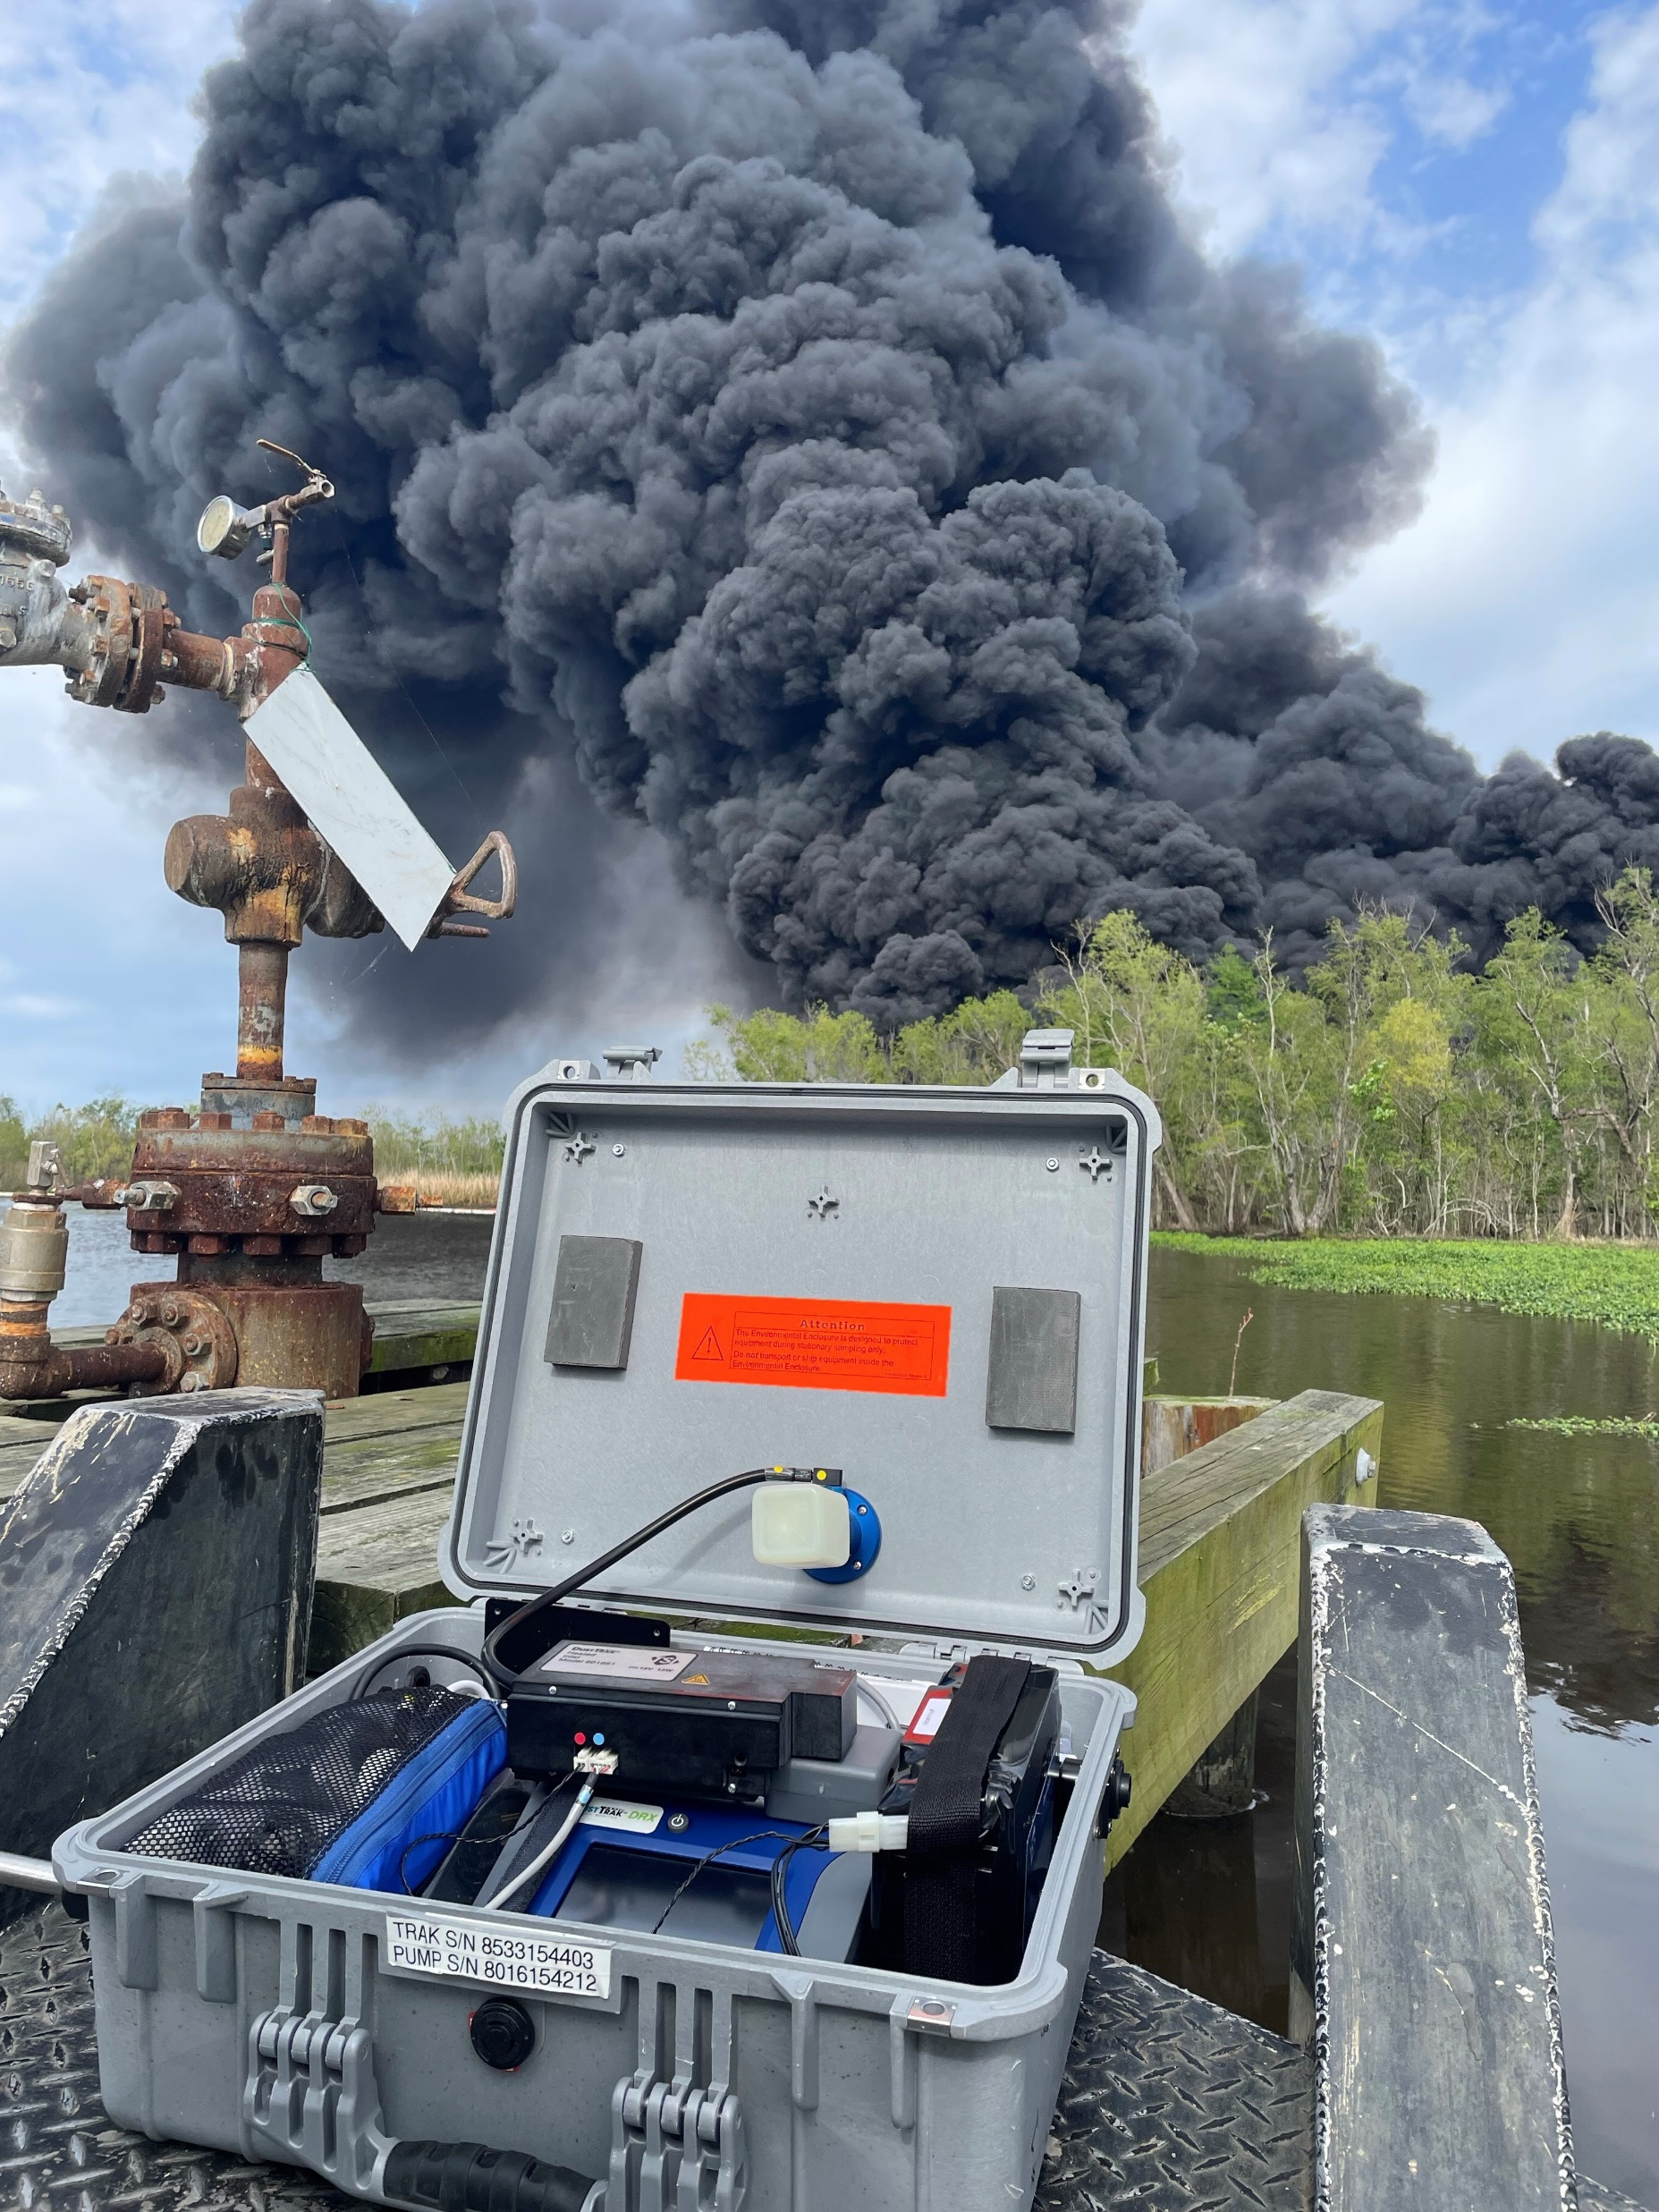
National Strike Force
NSF 017-24 Houma In-Situ Burn
10 –11 March
  Overview:
6 March, 40-60 bbl crude oil discharge occurred from a 3-inch flow line owned by Whitney Oil & Gas, LLC in Houma, LA.
10 March, MSU Houma received RRT VI approval for in-situ burn
NSF deployed 5 members to provide MSU Houma with air monitoring and contractor oversight using 2 MultiRaes and 3 DustTraks.
(Below) NSF responder with DustTrak at facility nearby .
(Above) Contractor proposed air monitoring locations.
(Below) DustTrak on contracted vessel with in –situ burn in background.
Outcome
Air monitoring:
    Air monitoring teams consisted of 2 Strike Team members
    DustTraks located in 2 strategic locations.
    Use Blue for updates & change.
    Monitored particulate concentrations for prescribed action levels for PM-2.5 and PM-10M.
    Paper logs documenting concentrations taken every 15 minutes.
Contractors burned XX % of the ~60bbl spill 04 hours after ignition.
(Above) NSF responders setting up DustTrak before boarding contracted vessel.

Slide 19


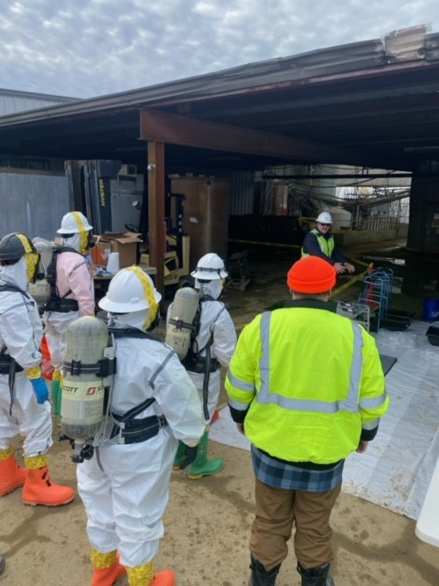
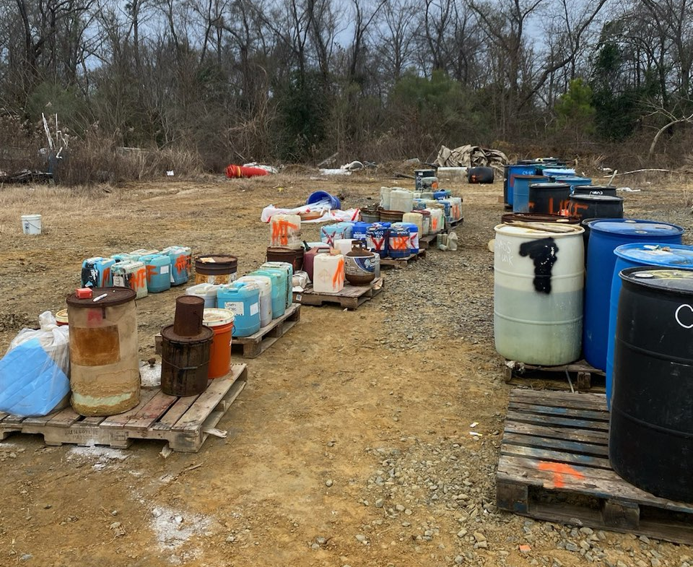



National Strike Force
NSF 010-24 Aerospace Defense Coatings
Update as of 07 February
Current Operations
Approximately 700 containers and 100 vats of various chemicals onsite.
EPA contractor Tetra Tech conducting Hazard Categorization (HAZCAT) and sorting of like materials.
EPA contractor KEMRON sorting and overpacking identified chemicals.
GST providing 1 Response Supervisor, 1 SOFR/EMT, 2 Decon, and 2 Air Monitoring. GST Industrial Hygienist assisted with site setup and ICS-208 review.
As of 07 Feb the site has been shut down awaiting remobilization.
(Below) Containers categorized by contents and staged for overpacking.
(Above) GST demonstrating decontamination procedures.
Future Operations
Ensure safety of responders throughout 3-Phase operation:
  Phase I: HAZCAT
  Phase II: Sort/Overpack
  Phase III: Ship for disposal
Following Phases I and II, operations will pause, allowing EPA to secure a contract for disposal (27 Jan).
Phase III: anticipate remobilization of GST to provide contractor oversight for disposal operations (approx. MAY 2024).
(Below) GST and Tetra Tech observing contractor entries.
(Above) GST HMRT on site as Staging Area.
Two alternate photos. “Containers categorized by contents and staged for overpacking”
Notes:
The National Strike Force deployed on 7JAN24 to support US EPA Region IV (OSC) in response to an electroplating facility Superfund Site in Macon, GA. The site was once owned and operated by Aerospace Defense Coatings but has since been abandoned.

Slide 20

U.S. Coast Guard
National Strike Force
CAPT Melanie Burnham
Commanding Officer
LCDR Elizabeth Tatum
Executive Officer
PH: (251) 441-6601
World’s Best Crisis Leaders and Technical Responders
Any Time, Any Place, Any Hazard

